Slide 1
Joining tables using inner joins

Slide 2
Why do we need to join tableS?
EMP table
ISON WITH LAST YEAR
DEPT table
If you are asked to write a report listing the employee number, their name and the name of the department they work for, you cannot do this by selecting from one table alone, you have to join the EMP and DEPT tables together.

Slide 3
How do we join tables together?
Deptno (Foreign key)
Deptno (Primary Key)
EMP table
matches
ISON WITH LAST YEAR
DEPT table
To join the EMP and DEPT tables together you need to use the common column between the two tables – DEPTNO
Join columns are the primary key in the master table and the foreign key in the detail table.

Slide 4
How do we join tables together?
SELECT empno, ename, dname
FROM emp
INNER JOIN dept ON emp.deptno = dept.deptno;
EMPNO | ENAME | DNAME
7369 | SMITH | RESEARCH
7499 | ALLEN | SALES
7521 | WARD | SALES
7566 | JONES | RESEARCH
7654 | MARTIN | SALES
7698 | BLAKE | SALES
7782 | CLARK | ACCOUNTING
7788 | SCOTT | RESEARCH
7839 | KING | ACCOUNTING
7844 | TURNER | SALES
7876 | ADAMS | RESEARCH
7900 | JAMES | SALES
7902 | FORD | RESEARCH
7934 | MILLER | ACCOUNTING

Slide 5

Inner join
CUSTOMER
ORD
Only show rows that are common to both tables
e.g. only customers who have placed orders

Slide 6
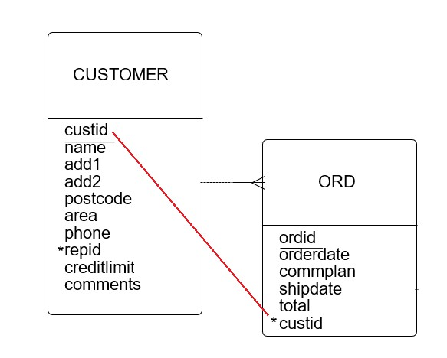
Two table inner join example
List the customer id,
customer name, order id,
order date and total of all
orders. Sort by customer id
and then order id.
Common column is custid so
this is the way we join the two
tables together as follows:

Slide 7
Two table join example
SELECT customer.custid, name, ordid, orderdate, total
FROM ord
INNER JOIN customer ON ord.custid = customer.custid
ORDER BY customer.custid, ordid;
Query result:
Customer table
CUSTID | NAME | ORDID | ORDERDATE | TOTAL
100 | JOCKSPORTS | 606 | 14/07/2004 | 3.4
100 | JOCKSPORTS | 609 | 01/08/2004 | 97.5
100 | JOCKSPORTS | 620 | 12/03/2005 | 4450
100 | JOCKSPORTS | 621 | 15/03/2005 | 730
101 | TKB SPORT SHOP | 610 | 07/01/2005 | 101.4
102 | VOLLEYRITE | 602 | 05/06/2004 | 56
102 | VOLLEYRITE | 603 | 05/06/2004 | 224
102 | VOLLEYRITE | 611 | 11/01/2005 | 45
CUSTID | NAME
100 | JOCKSPORTS
101 | TKB SPORT SHOP
102 | VOLLEYRITE
103 | JUST TENNIS
104 | EVERY MOUNTAIN
105 | K + T SPORTS
106 | SHAPE UP
107 | WOMENS SPORTS
108 | NORTH WOODS HEALTH AND FITNESS SUPPLY CENTRE
109 | KW SPORTS
107 | WOMENS SPORTS | 615 | 01/02/2005 | 710
108 | NORTH WOODS HEALTH AND FITNESS SUPPLY CENTRE | 613 | 01/02/2005 | 6400
Customer 109 is a new customer and doesn’t yet have any orders so with an inner join, doesn’t appear in the query result

Slide 8
Column ambiquity
SELECT custid, name, ordid, orderdate, total
FROM ord
INNER JOIN customer ON ord.custid = customer.custid
ORDER BY custid, ordid;
The above query will generate the following error:
‘Error while executing SQL query on database : ambiguous column name: custid’
This happens when you use a join column in a WHERE or ORDER BY clause as SQLite doesn’t know which custid to use. To overcome this, prefix with the table name e.g. customer.custid

Slide 9
Table aliases
SELECT customer.custid, name, ordid, orderdate, total
FROM ord
INNER JOIN customer ON ord.custid = customer.custid
ORDER BY customer.custid, ordid;
We can abbreviate the table names with table aliases to save typing and make the queries more readable as follows:
SELECT c.custid, name, ordid, orderdate, total
FROM ord o
INNER JOIN customer c ON o.custid = c.custid
ORDER BY c.custid, ordid;
o is the table alias for ord and c is the table alias for customer

Slide 10
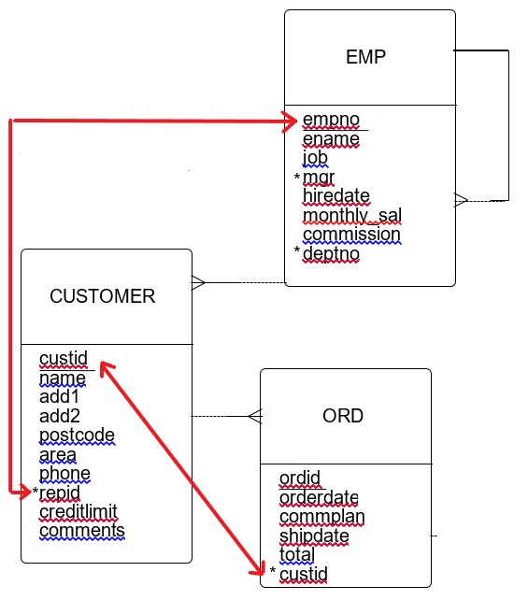
Three table inner join example
List the order id, total
customer name and sales rep name for all orders. Sort by sales rep name and then order id.
Need to join ord to customer
and customer to emp.
Linking column between
customer and emp is primary
key of emp table (empno)
and foreign key in customer
table (repid). They don’t
necessarily have the same name.

Slide 11
Three table inner join example
SELECT ename, name, ordid, total
FROM ord o
INNER JOIN customer c ON o.custid = c.custid
INNER JOIN emp e ON c.repid = e.empno
ORDER BY ename, ordid;
Query result:
ENAME | NAME | ORDID | TOTAL
ALLEN | EVERY MOUNTAIN | 607 | 5.6
ALLEN | EVERY MOUNTAIN | 608 | 35.2
ALLEN | EVERY MOUNTAIN | 612 | 5860
ALLEN | WOMENS SPORTS | 615 | 710
ALLEN | EVERY MOUNTAIN | 619 | 1260
MARTIN | VOLLEYRITE | 602 | 56
MARTIN | VOLLEYRITE | 603 | 224
MARTIN | TKB SPORT SHOP | 610 | 101.4
MARTIN | VOLLEYRITE | 611 | 45

Slide 12
inner join WITH OTHER CONDITIONS
SELECT ename, name, ordid, total
FROM ord o
INNER JOIN customer c ON o.custid = c.custid
INNER JOIN emp e ON c.repid = e.empno
WHERE total > 2000
ORDER BY ename, ordid;
Query result:
ENAME | NAME | ORDID | TOTAL
ALLEN | EVERY MOUNTAIN | 612 | 5860
MARTIN | VOLLEYRITE | 614 | 23940
MARTIN | VOLLEYRITE | 618 | 3510.5
TURNER | NORTH WOODS HEALTH AND FITNESS SUPPLY CENTRE | 613 | 6400
TURNER | K + T SPORTS | 617 | 46370
TURNER | JOCKSPORTS | 620 | 4450
WARD | SHAPE UP | 605 | 8324

Slide 13
NUMBER OF JOIN CONDITIONS
When you join x tables together, you will require a minimum of x-1 join conditions.
Number of joined tables | Min. number of join conditions required
2 | 1
3 | 2
4 | 3
VERY IMPORTANT!
If you forget some join conditions, you will get a cartesian join which will result in lots of duplicate rows!

Slide 14
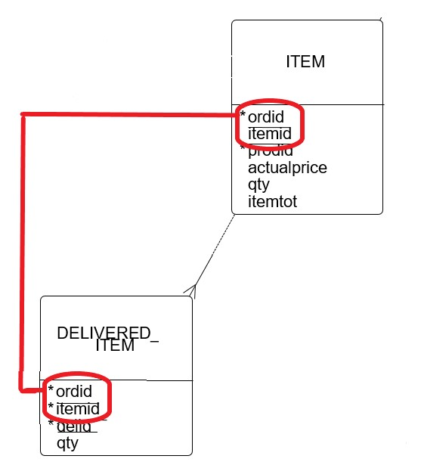
Joining tables with composite keys
List the order id, item id,
quantity ordered and quantity delivered. Sort by order id
and item id.
Need to join item to delivered_item.
These tables have a composite
(sometimes called compound)
key consisting of ordid and itemid so we have to join using all parts of the key.

Slide 15
Joining tables with composite keys
SELECT i.ordid, i.itemid, d.delid,
i.qty AS ‘Order Qty’, d.qty AS ‘Delivered Qty’
FROM item i
INNER JOIN delivered_item d ON d.ordid = i.ordid
AND d.itemid = i.itemid;
ORDID | ITEMID | DELID | ORDER QTY | DELIVERED QTY
610 | 1 | 100005 | 1 | 1
610 | 2 | 100005 | 3 | 3
610 | 3 | 100005 | 1 | 1
611 | 1 | 100001 | 1 | 1
612 | 1 | 100008 | 100 | 75
612 | 1 | 100009 | 100 | 25
612 | 2 | 100008 | 20 | 20
612 | 3 | 100008 | 150 | 100
612 | 3 | 100009 | 150 | 50
612 | 4 | 100008 | 100 | 100
Query result:

